Slide 1
Filling the Vacuum: who will save multilateralism?
Public lecture by Mikael Barfod, Visiting Professor,
Huddersfield University, 22 January 2019

Slide 2
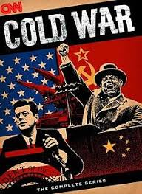
Multilateral organisations have never been perfect
Supranational (EU) vs. international powers (UN)
Cold War: East, West or non-aligned
Post Cold-war:
Universality of human rights
Entrenched positions and new divisions
Participate or withdraw
International Law of the Seas and Intyernational Criminal Court
Exterritoriality

Slide 3
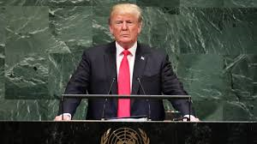
New US philosophy on multilateralism
America first
National sovereignty rules
Zero-sum game
Populist creed

Slide 4
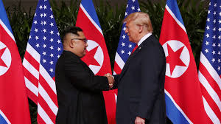
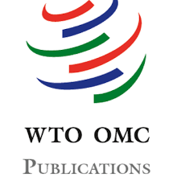
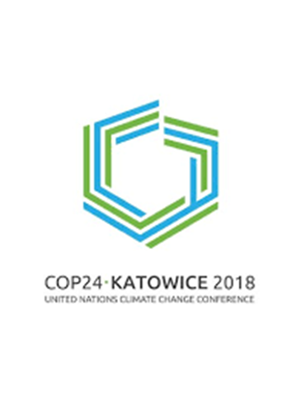
Trump’s actions on multilateralism
Shifting enemies
Trade wars or bilateral power games?
World Trade Organisation
Paris Climate Agreement
Human Rights Council
Human Rights abuse
Regional peace negotiations

Slide 5
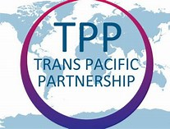
Recent US withdrawal from multilateral commitments
Trans-Pacific Partnership
UN - female reproduction.
UNHCR (UN High Representative for Refugees)
UNWRA (Relief and Works Agency for Palestine)
The US Muslim Ban
“Bad Hombres” and the US-Mexico wall
Separation of children from arrested parents of illegal immigrants
UN Global Compact for Migration
Withdrawal from the Universal Postal Union (UPU)
And counting …?

Slide 6
Reaction in the United States
Checks and balances
Negative consequences?
Multilateral skepticism may persist beyond Trump

Slide 7
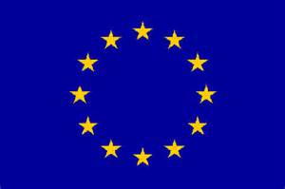
Reaction in Europe
EU and UN values aligned
Growing importance of UN to the EU
US administration’s skepticism towards EU & UN:
(1) unifying effect within EU
(2) weakening effect
“Rebels” within the EU
Trump-like parties have a “sugar daddy”
Human rights issues within the EU

Slide 8
How can multilateralism survive current trends?
American democratic values behind League of Nations and UN
UN designed to avoid effects of Realpolitik in 1930s
Current US attacks on multilateralism only gives legitimacy to national decisions
Science demands global solutions
Who can fill current vacuum left by US?

Slide 9
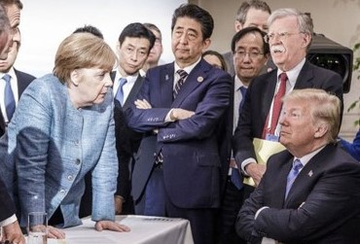
EU could lead rebuilding of multilateralism & reform of UN
EU’s commitment to effective multilateralism.
EU’s State-like status & the only full participant non-state actor in UN
EU is largest financial contributor to UN
EU supports the UN reform agenda
EU can help to rebuild & reform in open-ended international partnership with all countries, including the US

Slide 10
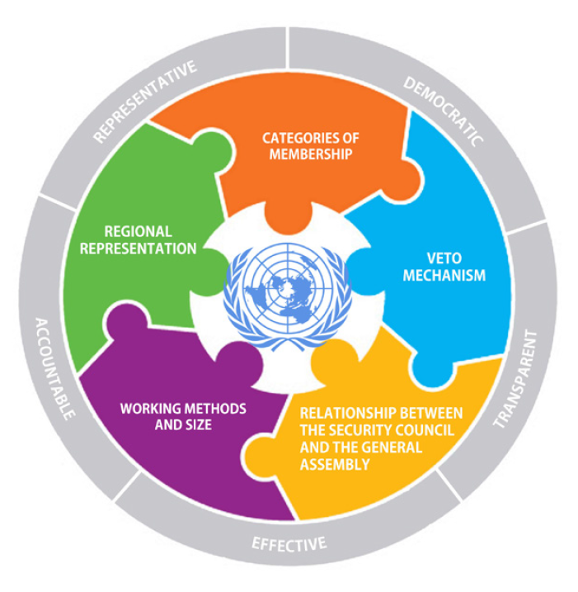
Why is the UN ready for reformS?
Growing political consensus on many aspects of reform
Needs to be better equipped to face modern threats (irregular conflicts, global pandemics, climate etc.).
Reforms are demanded by an increasingly influential non-state actors (including NGOs, think tanks, religious communities and academia).
regional and sub-regional partners could boost the UN to better define its role
UN Security Council is unrepresentative. Europe could be represented by the EU.
Reform

Slide 11
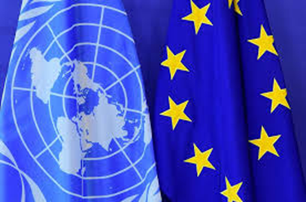
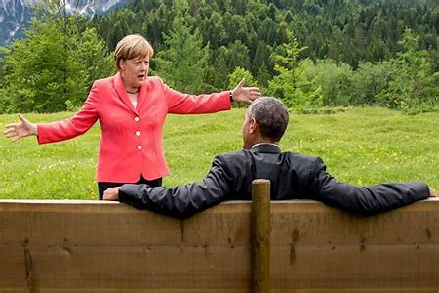
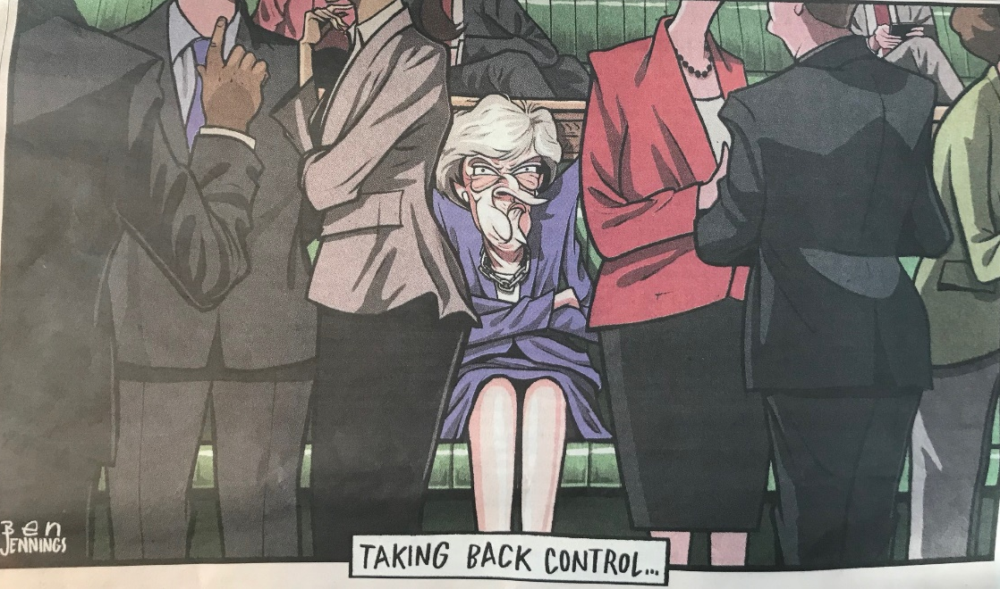
Conclusion
Multilateralist agendas have always been difficult to implement
Populism and new US administration has cause serious damage that could be irreparable
EU could lead international agenda to rebuild/reform UN
EU needs effective multilateralism itself and could bring the US back
UK can play a role IN or OUT of EU

Slide 12
Thank You
@MBarfodEU
M.Barfod@hud.ac.uk

