Slide 1




None in Three
Inaugural Annual Conference
September 2021
Writing Successful Research Proposals
Dr Nadia Wager
None in Three is funded by:

Slide 2

Types of proposal
As part of the application for post graduate study.
Ethics proposals
Grant applications
Responses to tenders
https://www.pinterest.co.uk/pin/415527503093582157/

Slide 3
Key stages in writing any proposal
Framing the project problem (i.e. what do we want to solve)
Learning & researching about the problem (literature review, conversations with key stakeholders etc.)
Laying the project’s logical framework & sketching out ideas for activities (i.e. what could be the solutions)
Visualising the proposal (A to Z) – lay out the logical order of events
Getting relevant feedback (seek out experts in the field and ask them to provisionally review your ideas) & making suggested revisions
Finalising the project plan & only then starting to write the final proposal
Submit and hope for the best
If rejected, where possible, seek feedback
Revise and resubmit

Slide 4
Framing the research problem
How do you know there is a problem?
Can you evidence this?
Are you able to articulate the problem in a simple sentence or two?
Have you framed the problem in a way that lays blame on the very people you hope to instigate change with or for?
Why is this relevant?
  Who of what is likely to be impacted if this isn’t resolved?
  What is the likely extent of any negative impact?

Slide 5
Learning about the problem
Explore the literature – what is already known about the problem
  Start with looking for review articles
  Then look to articles that have been published since the last literature review.
What do you hope to glean from the literature?
  What research questions have previously been proposed?
  What methods have other researchers used to study this phenomenon?
  What are the strengths and weaknesses of these methods?
  What scales or tools have other researchers used?
  What have been the inclusion and exclusion criteria for participants/data in previous studies?
  What practical procedural issues have been implicated in conducting research in this area or with this population?
  What ethical issues were identified in the previous studies and how were these addressed?
  What theoretical perspective have been applied to studying this phenomenon?

Slide 6
Identifying stakeholder groups
Who has a vested interest in the problem you are planning to research? Think in terms of:
  Organisations who might be able to use your research findings to inform their practice
  Groups of individuals who are affected by the way in which the research in conducted and/or the way the findings are presented.
  Powerful individuals – those who might be positioned to inform policy
  Knowledgeable individuals – who are deemed to be experts in the area

Slide 7
Logical sequence of activities
Having framed the problem and understanding the gaps in knowledge and the contextual considerations you can now begin to plan for your research activities.
You will need to clearly define your objectives that will help you fulfil your research aim.
Each research activity you plan to undertake will need to map onto one or more of these objectives.
Think how each stage might inform the next or support in gaining participants.
Identify each of the key milestones

Slide 8
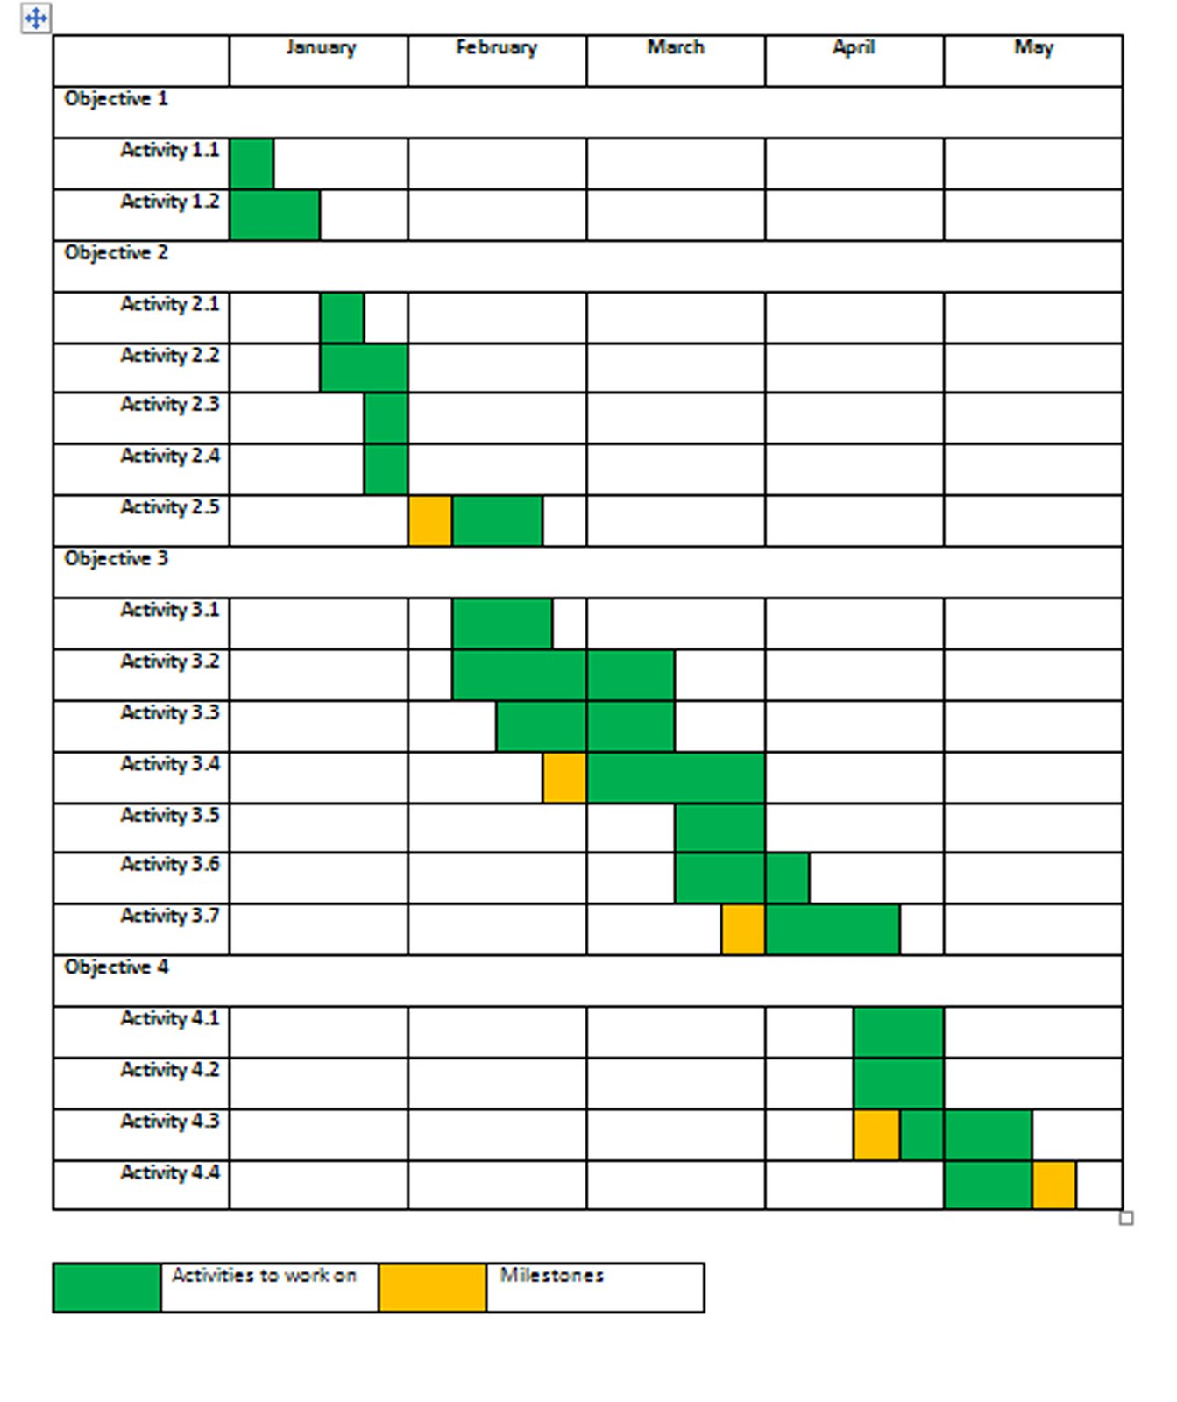
Visualising the proposal

Slide 9
Tweaks for different audiences
PhD applications
Ethics Proposals
Grant applications
Responses to tenders

Slide 10
Helpful sources
https://www.ukri.org/councils/esrc/guidance-for-applicants/how-to-write-a-good-proposal/
https://www.ahajournals.org/doi/epub/10.1161/CIRCRESAHA.114.303695
IJOrtho-41-23.pdf (nih.gov)

