Slide 1
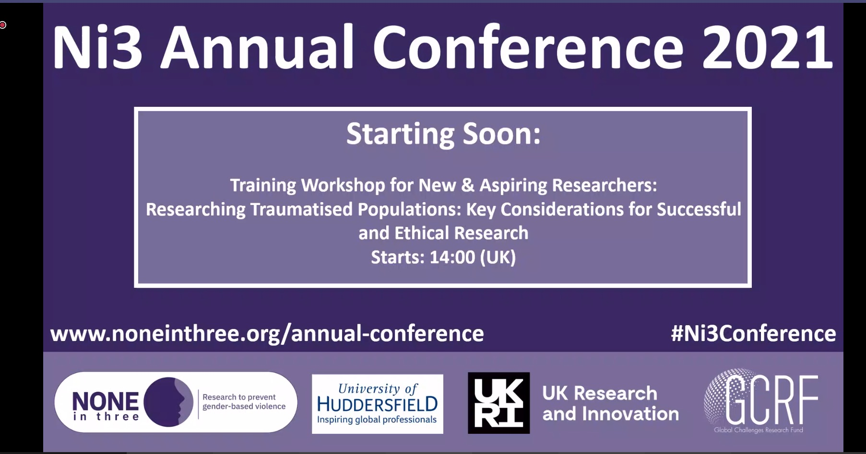
Qualitative research as a guide for developing realistic prosocial games: An overview of findings from four countries
Dr Tim Gomersall, Senior Lecturer in Psychology & Work Package 2 co-lead

Slide 2
Qualitative research: Key assumptions
Knowledge is always context-specific
Valuing research participants’ subjective experience
Focus on ‘naturally occurring’ data: better reflection of the ‘real world’
Critical and questioning perspective on life
Interest in meaning over measurement
Importance in creating games that resonate

Slide 3
Ni3 Qualitative approach – general overview
Specific country focus: Developed with local expertise from:
Ni3 country teams
Stakeholders (local practitioners, non-profits, NGOs, women’s support services)
Combination of interviews and focus groups in each country
Purposive sampling of participants (recruiting people who would be best placed to tell us about our research focus)
Focus on gathering ‘rich’ data

Slide 4
Country focus: India
The relationship between gender bias and GBV
Context:
One quarter of Indian women are in/ seeking work (vs 82% of men)
Limitations placed on women’s mobility outside the home
Prioritising of boys’ education
Importance of multi-generational households in India for transmitting ‘traditional’ gender roles
Practice of Dowry remains widespread despite legislation
Evidence of GBV as widespread (estimates of prevalence generally between 28.7 to 42%)
High acceptance of GBV as ‘normal’ part of women’s roles (56% in Nambi, 2011)

Slide 5
Key findings: India
Women encouraged to accept violence as “normal”:
“[…] My mother told me that if somebody tells you anything, I should not answer back. I should tolerate it because I have to stay there [marital home], to ask them [in-laws] if there was any mistake in my understanding, and since I don’t have a mother-in-law, to ask the elders.
M: What else did she advise you?
R: To make good food, and if anything hurts me then not to bother, just ignore, and listen to what the other person is saying.”- Madhu, 60, IDI 14

Slide 6
Importance of challenging cultural norms
“[T]here is an Act for women who go through physical violence, that you can go and tell the police what the truth is. Police helps people who are in trouble. But we should complain only if we are against the perpetrator. There are many women who don’t say anything thinking about the respect of their family. This I think is very wrong. These women are bearing so much in the name of respect, that should not happen.” – Anushka, 24, IDI 7

Slide 7
Women’s autonomy: Education and choice over marriage
“After marriage, you are stressed because of your husband, your kids, and your house responsibilities. I always advise all the girls to never marry and if they get married they should not leave their jobs because if you have financial independence, you don't have to beg for money from your husband. I would say don't get married as there are so many problems after marriage that it is better not to get married at all.” – Teju, 42, IDI 11

Slide 8
Hence I was not interested in studies, because in our home, girls were not allowed to go out for long. They were supposed to stay at home. So I thought what is the use of studying? If I study but I am not allowed to work, then my future is going to get spoilt anyway. […] He [father] never realised, that so what if I'm a girl? He never bothered to recognise my talent and support me in moving forward.” – Reeti, 31, IDI 24

Slide 9
Country focus: Jamaica
Child sexual abuse: Impacts and barriers to disclosure
Context;
CSA and trafficking identified as serious issues by stakeholders and Jamaica Ni3 researchers
Policies to reduce violence against children in place, but “structural and systemic inadequacies” to address (UNICEF, 2018)
Beliefs that prevent CSA disclosure are widespread (more on this later)

Slide 10
Jamaica key findings: CSA takes many forms, not all involving contact
“So what he'd do is give me one a dem (one of those) sex magazines, and he would just a- d-like, I mean I'm a child so I don’t know th, so, but he'd say to me, yuh (you) like this style or yuh (you) like this style, showing me the different positions (sexual positions) and y'know?”- [Hope A, 35 y.o.]
“However, ummm, he would say to me that I will not amount to anything, men will take advantage of me, I am a whore, I am a bitch…”-[Raven, 20 y.o.]

Slide 11
It was embedded in power relations:
“Alright, so the how, how it happened? So I, my parents broke up, yes and I was in between… a half of a home and nowhere... Yes, and I wanted to go to school… and then… here comes dis (this) man where… he would provide me with stuff, you know? Provide mi (me) with school and, stuff to go school, lunch money, all of those stuff and in in exchange right? Sexual advances were made”.- [Goodie, 27 y.o.]

Slide 12
CSA was normalised
“It felt like it was a norm. Like you just tell somebody and nothing happens. Yuh nuh (you know) you just tell just so you can say dat (that,) hey dis (this) happened to me, what are you going to do? But den (then) nothing is done, and it makes you feel as though, like what happened to you wasn't a big deal. Like just get over it. Yuh nuh (you know) and it felt like that was the norm even in our society, dat (that) when something bad happens to you as a female you know, just get over it”-[Grace, 25 y.o]

Slide 13
…And the response of family members was critically important
“she never said anything…..I didn’t get any justice from my mother. She didn’t say to me that he was wrong for doing it”- [Marie, 47, y.o]
“Soh (so) it was terrifying fah (for) me. An becass (and because) my father wanted justice. He always drag me through it an seh (and said), come on wi (we) need fi (to) do dis (this)”- [Kelly, 29 y.o]

Slide 14
Country focus: Uganda
Child marriage
Context:
Sub-Saharan Africa has the highest global prevalence of child marriage: 40% of girls marry <18 (UNICEF, 2018)
Legacy of the civil war in Uganda
National Strategy to End Child Marriage & Teenage Pregnancies 2014 – but the practice remains widespread

Slide 15
Uganda key findings: Schooling and marriage
“She couldn’t afford to pay my school fees. We were very many and yet she had remained alone; so paying our school fees and meeting all our other needs was very challenging to her, she couldn’t manage.”(Atwendya, a Child Marriage Survivor)
“Those girls, no parent will tell her that you go and get married to Junior, no. They will make the decision for themselves; to get married when they are below 18 years. They think they are mature, and when you send her to fetch water she does not come back; and when you reprimand her, she will say that you are mistreating her, then she runs away and gets married.” (FGD with Female Community Members, Central Region)

Slide 16
Me there wasn’t really anything wrong but only bad friends who advised me to go for marriage and I thought that was the right decision and later realized it was a bad decision. (Ayaa, a Child Marriage Survivor)
I think it’s mainly peer pressure that drives girls to get married, especially when they are in groups with fellow teenagers, they tend to go to music shows and concerts, dance clubs, where they get men who marry them. For example, I remember when I was still in school some friends would tell me about having boyfriends who usually bought them nice clothes and other luxuries. So they were trying to advise me to get one. (Atwendya, a Child Marriage Survivor)

Slide 17
The role of teen pregnancy
Some few girls take themselves into child marriage, but the vast majority are forced into it. Sometimes events happen to the child which force them into child marriage. For example, they may be carrying an unplanned pregnancy with no other viable solution to the problem. She might be forced to leave the current home where she has been staying because her parents insist that she must leave. Then she goes to live with the boy who impregnated her. Alternatively, the girl may have been found in a compromising position with the boy and then fears to return to her parents. Therefore, she decides to permanently elope with the boy. (FGD with Male Community Members, Central Region)

Slide 18
Abuse in the family home:
For me I got married when I was only 13 years old because both of my parents died. I was staying with my uncle, but my uncle’s wife was very harsh towards me. Whenever she was at home, even eating was a problem. I would only get some relief when she was not at home. I never had anyone to cater for my basic needs, life was hard, so when I met my husband, I thought life would be better… (FGD with Female Community Members, Northern Region)

Slide 19
The legacy of war
First of all, I wasn’t interested in getting married by that time, but I was abducted by LRA rebels when I was 12 years old and forcefully given to a man who impregnated me then I gave birth to a baby. (Acaa, a Child Marriage Survivor)
When there is conflict you find that families live in unsafe regions like what happened here with the LRA activities. In these kinds of circumstances, you find that parents may genuinely believe that marrying their daughters is the best way to protect them from danger. (Atuku, a Child Marriage Survivor)

Slide 20
Country focus: UK
Survival of intimate partner violence / barriers to leaving violent relationships
Context:
High prevalence of IPV among women in the UK: 13-31% in population studies; 13-41% in clinical studies (Feder et al. 2009)
Likely to be under-estimates
Growth of new network technologies (social media, mobile phones, tracking) enable new forms of control (Bailey et al., under review)

Slide 21
Key findings: UK – importance of non-physical abuse
‘From my experiences it can be different for everyone, I’ve heard people say sort of domestic violence they think automatically of you know, people getting punched and hit, but it’s not just that, that’s just part of it, so it’s the emotional stuff that comes with it, and the control, and... to me that’s worse than being sort of physically assaulted, which sounds really backwards but for me, I’d take a punch in the face every day, like, quite happily’ (ST).

Slide 22
Sexist/ anti-woman cultural norms
‘…there’s some things that he did that so many other guys did as well that it just kind of felt normal, you know? Like the shaming for having sex with other boys - it happened to me, I got bullied a lot in school for that…called me a ‘slag’…I thought the things he was telling me were true…so I just thought when I got with him that it was all normal…because it was ingrained in my head what other guys had done’ (Katie).
‘I think he got enjoyment from the power. I think he was someone who didn’t feel like he had much power and control in his life, or respect’ (Lisa).

Slide 23
Alcohol and drug abuse
She recounted how he had obtained cocaine using money that was needed for their baby, leaving her with only five pounds. Claudia also described being forced to fund her partner’s cannabis habit, which left her unable to eat properly and losing a lot of weight. Beth said that when her abuser ran out of cannabis his behaviour escalated. She also said that things got worse the day after her abuser took cocaine – when he was on a ‘comedown’. Blue recounted how addiction turned her partner from being ‘the most beautiful thing ever imaginable’ to ‘a monster.’

Slide 24
Understanding healthy relationships
‘I’d never really had much of a dating experience, let alone you know, to form a knowledge of what is okay and what isn’t okay, and what to expect, so my experiences quite young of dating were really negative, and it kind of sent me to a place where I didn’t value myself enough to kind of.. be with someone that treated me properly. So even though I only had that one sort of, you know, abusive relationship, every relationship I had spanning onwards from that wasn’t healthy… And, I think that stemmed from what I’d experienced as my kind of first proper relationship’.

Slide 25
Gradual wearing down
‘He’d say all of the time…things like erm, I was the fattest girlfriend he’d ever had, like he was some sort of charity and he was good to me for being so, erm, dismissive of my obvious faults’ (Rivers).
‘I was like damaged goods, no-one else would touch me, you know. He was doing me a favour staying with me’ (Claudia).

Slide 26
Technology-mediated control
‘He would make me text people in front of him things to see what their response would be... if someone followed me on Instagram…”who’s that? Block them instantly”, my erm, my sister’s ex-boyfriend…we were amazing friends…my boyfriend made me text him saying like “fuck off, I don’t want anything to do with you…never contact me again” and block him on everything, and as far as he knows, that came from me’ (Eva).

Slide 27
Bringing it together: Common themes in diverse contexts
Need for education on GBV, sexual health, and healthy relationships
Empowerment of women and girls – economic, political, educational
Importance of involving men and women in efforts to reduce GBV
Challenging damaging gender norms

